Slide 1
Limbaje formale si automate
Seria 13
Saptamana 7, 3 apr 2013
Andrei Paun

Slide 2
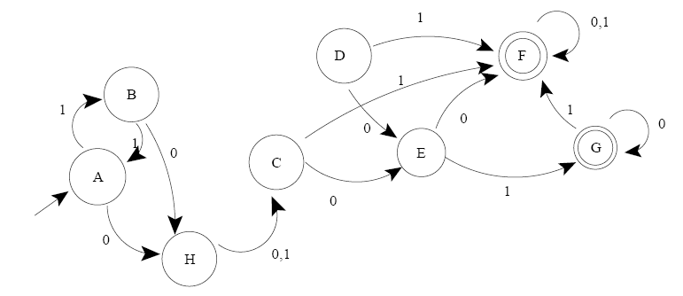

Slide 3
